Slide 1
Information Technologies (ICTs) –Quo Vadis?
Prof. Dr. Axel Lehmann
Institut für Technische Informatik,
Universität der Bundeswehr München, Germany
and
Institut für Technik Intelligenter Systeme (ITIS) at
Universität der Bundeswehr München, Germany

Slide 2
ICTs – Where are these going ?
Predictions are difficult,
especially when it's about the future !
(Winston Churchill; Mark Twain; …. )

Slide 3
Historic Milestones of ICTs
The Driving Forces for ICTs <-> Digitalization !
Anniversaries:
1947/48: 1st Transistor developed 75th
1969: Start of ARPA-Network 54th
since 50´s: Begin of „AI“ research;
- 1st „AI-winter“ (70´s)
- 2nd „AI-winter“ (80´s)
1972/73: 1st Mobile phone (M.Cooper) 50th
1989: Birth of the WWW, 1st Browser, 34th
HTML (T. Berner-Lee)
1992/93: 1st Smartphone (IBM) 30th

Slide 4
Digital World – Where are you going ?
“The World is becoming an intelligent, digitally enabled mesh of people, things, and services.”
(Gartner Group Inc., 2017)

Slide 5
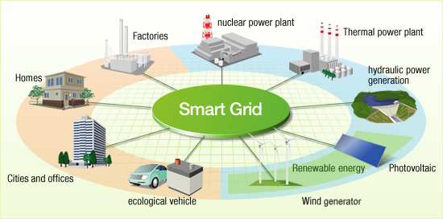
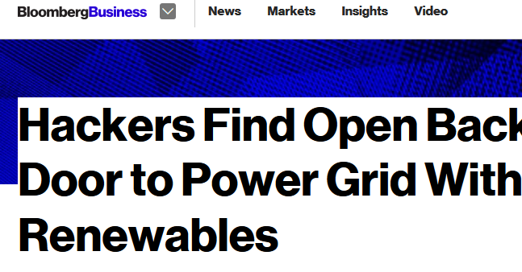
ICT Trends -> e.g. “Smart” Grids
From: http://cleantechnica.com/2014/02/19/global-smart-grid-investment-grows-china-leads-us-falls-behind

Slide 6
Major Key Trends of ICTs … (1)
„Classical“ physics:
→ Semiconductor technologies, e.g.:
    Sensor & actuator technologies
    Wide range of computing devices (smartphones, GPUs…, HPC)
    Cyber-physical systems
    Digital Twins
    VR/AR/XR (Virtual / Augmented / Mixed Realities)
    Communication networks, e.g. 5G
    Increasing computing performance & storage capacities

Slide 8
Major Key Trends of ICTs … (2)
High-Performance-Computers:
−> Sunway TaihuLight: 93 Peta-FLOPS = 93x10¹⁵ −> Design of Exascale Computing: 1 trillion = 10¹⁸ FLOPS
(e.g. Tianhe-3)
(Zetabyte)-Storage Capabilities:
−> 1 Zettabyte (ZT) = 10²¹ bytes; since 2016: 16 ZT;
1 Gigabyte GB = 1’000’000’000 Bytes (1’000 MB’s)
1 Terabyte TB = 1’000’000’000’000 Bytes (1’000 GB’s)
1 Petabyte PB = 1’000’000’000’000’000 Bytes (1’000 TB`s)
1 Zetabyte ZB = 1´000`000`000`000`000`000`000 (1’000 EB’s)
Estimates: in 2025: 165 ZT
1 Exabyte EB = 1’000’000’000’000’000’000 (1’000 PB’s)

Slide 9
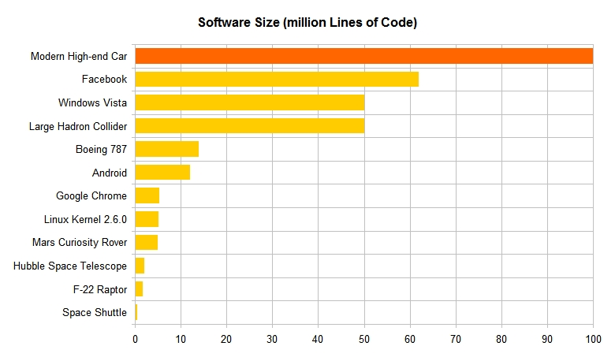
Software Complexity (in Lines of Code, LOC)
Image: https://www.linkedin.com/pulse/20140626152045-3625632-car-software-100m-lines-of-code-and-counting

Slide 10
Other Key Principles / Trends of ICTs … (4)
  …… new computing principles, e.g.:
  Parallel & distributed processing
  Bio-analogue / Organic Computing −> self-x-properties (x = adapting, organizing, repair, ….)
  Quantum communication & computing (?)

Slide 11
Other Key Principles / Trends of ICTs … (5)
  Neural Computing (artificial neural nets) −> reasoning by induction e.g:
  Artificial Intelligence applications, such as:
      “Smart” systems
      Data analytics
      -> Machine learning (ML)
      -> Deep Learning
      Generative AI (e.g. ChatGPT, etc.)

Slide 12
The Future Digital World
A.I. poses a “risk of extinction” on par with pandemics and nuclear warfare !
Sam Altman, Demis Hassabis, Geoffrey Hinton et. al.
(in Fortune, May 30, 2023):

Slide 13
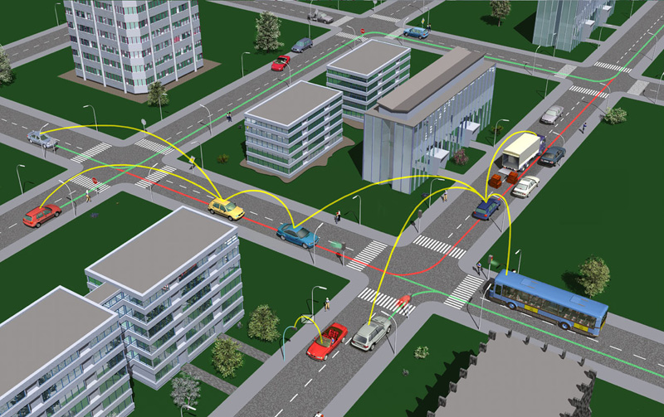
Software Complexity & Security Risks for Car 2 Car
Image: https://www.car-2-car.org/index.php?id=5

Slide 14
Problem: „System State Space Explosion“:
Simple functional analysis :
  reachability analysis for each state −>
  feasible for a state space size ≤ 10¹⁰⁰ !!
Numerical Analyses (of non-functional parameters, e.g. system´s performance / reliability in a specific state)
  for state space size ≤ 10⁹ (computable on a PC)
  ≤ 10¹⁰ (on a PC Cluster)
Full state space exploration is practically impossible ->
results in emergent system behaviour !!

Slide 15
Digital World – Major Challenges
Key Question for Scientists:
−> Mastering the complexity of these
“Systems-of-Systems”? (−> almost impossible !)
Required Basic Approaches for:
  International standards for verification, validation, certification, of components & systems
  Design of Resilient Systems (at all system levels !)
  Global development of norms & legal rules & ethical behaviour

Slide 16
Digital World – Challenges
Besides its tremendeous benefits,
the digital world
has already become
a top Planetary Emergency !

Slide 17
Information Technologies (ICTs) – Quo Vadis?
  Thank you very much
  for your interest
  and attention!

Slide 18
Cyber Security Challenges in Conjunction with Current Crises
Hamadoun Touré and Alex Ntoko: Technological Challenges - AI, Machine Learning, Quantum Computing
Pavan Duggal and Henning Wegener: Common Code of Conduct, Normative and Legal Rules
Sun Kun Oh: Social Responsibities for Data Ethics
Discussion

