Slide 1
Cyber security challenges in conjunction with current crisis – common code of conduct, normative & legal rules

Slide 2
A PRESENTATION BY DR. PAVAN DUGGAL ADVOCATE, SUPREME COURT OF INDIA CHAIRMAN, INTERNATIONAL COMMISSION ON CYBER SECURITY LAW PRESIDENT, CYBERLAWS.NET CHIEF EXECUTIVE, ARTIFICIAL INTELLIGENCE LAW HUB FOUNDER-CUM-CHANCELLOR, CYBERLAW UNIVERSITY CHIEF EVANGELIST, METAVERSE LAW NUCLEUS HEAD, PAVAN DUGGAL ASSOCIATES

Slide 3
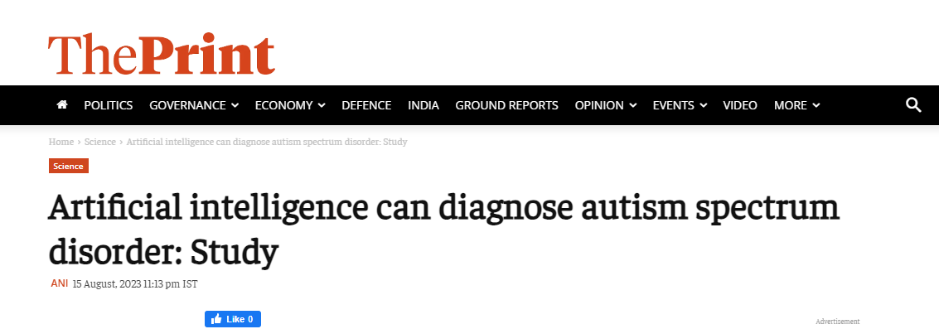
USE OF ARTIFICIAL INTELLIGENCE

Slide 4
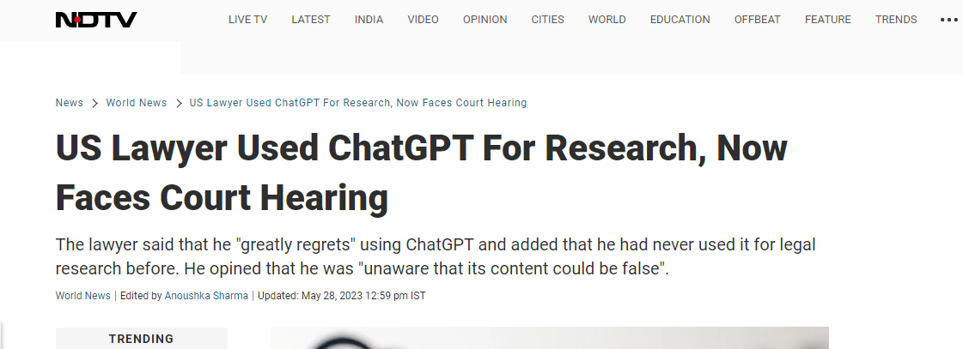
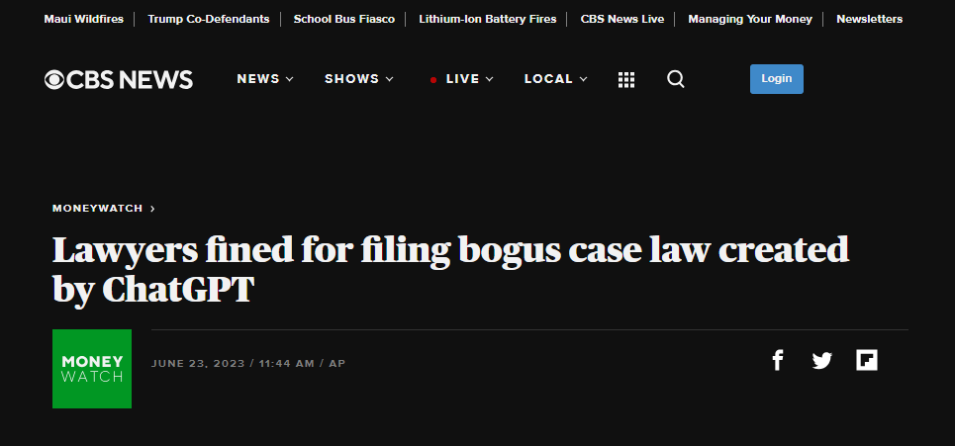
USE OF ARTIFICIAL INTELLIGENCE

Slide 5
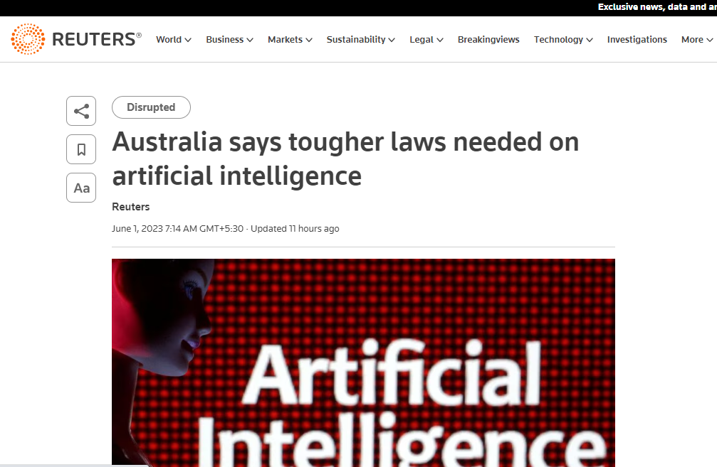
USE OF ARTIFICIAL INTELLIGENCE

Slide 6
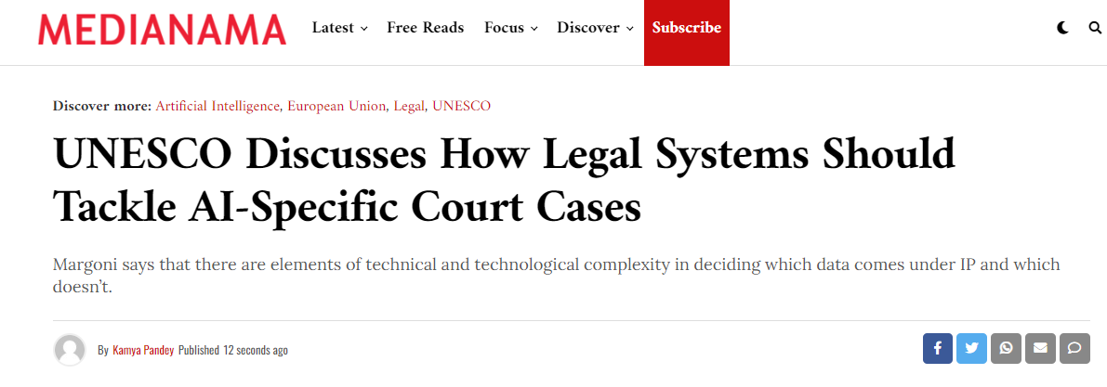
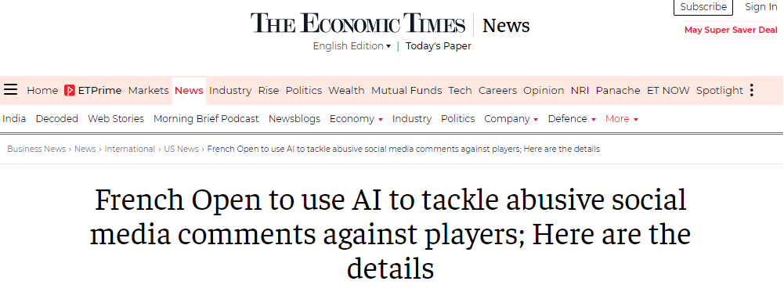
USE OF ARTIFICIAL INTELLIGENCE

Slide 7
ADVENT OF GPT-4

Slide 8
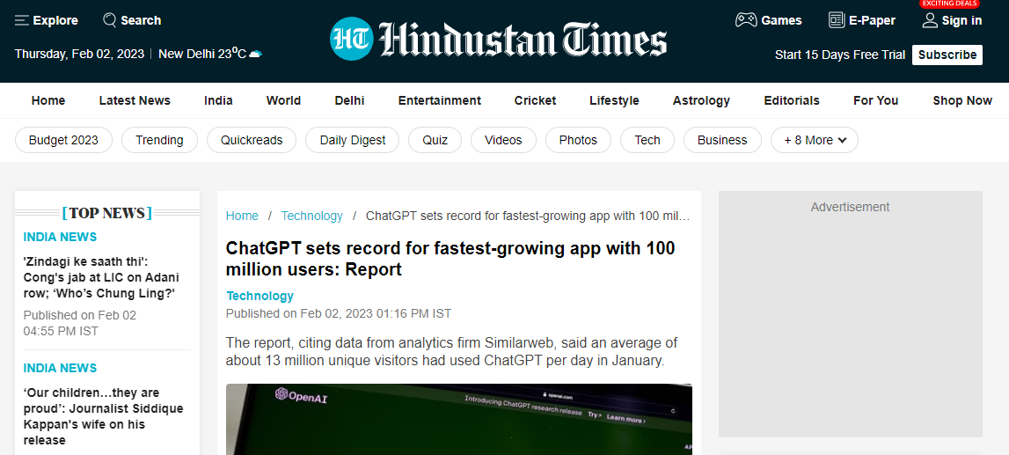
INCREASING USE OF CHATGPT

Slide 9
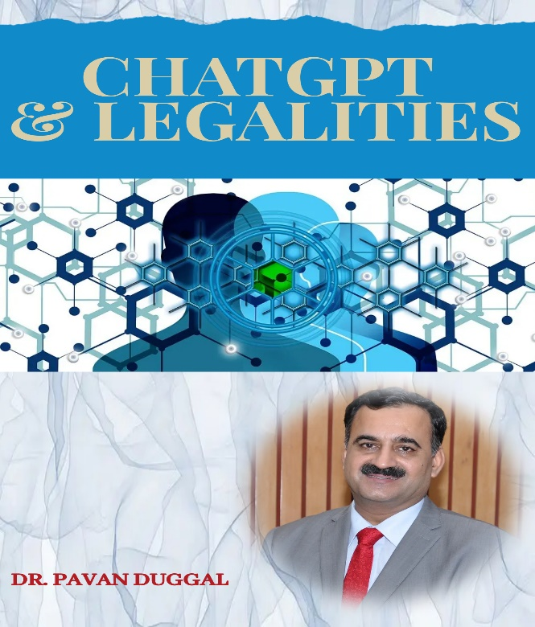
CHATGPT LEGAL ISSUES
The advent of ChatGPT has taken the world by storm.
Ever since ChatGPT got launched on 30th November, 2022, it has been extensively adopted by stakeholders across the world and no wonder, its number of users are growing up in a dramatic manner.
© of images belongs to the respective copyright holders

Slide 10
Artificial Intelligence and NORMATIVE requirements (CONTD…)
The potential consequences of the use of AI represent a considerable concern, and a number of different actors are attempting to develop normative frameworks in order to discipline its use.

Slide 11
CHATGPT LEGAL ISSUES (contd…)
Legality of Output of ChatGPT
Correctness and Authenticity of ChatGPT Output
Hallucination by ChatGPT And Connected Issues
Legal Liability for ChatGPT Output
Legal Responsibility of Coders And ChatGPT
Data Protection and ChatGPT
Data Privacy and ChatGPT
OpenAI And Data Protection Measures
© of images belongs to the respective copyright holders

Slide 12
CHATGPT LEGAL ISSUES (contd…)
Jail Breaking and ChatGPT
Crimes & ChatGPT
ChatGPT , Cyber Security And Developing New Type Of Malware Lack of International AI Law and Regulation
Applicability on National Laws On ChatGPT … and many more
© of images belongs to the respective copyright holders

Slide 13
Artificial Intelligence
Artificial Intelligence as a paradigm is increasingly gaining centre-stage attention.
© of images belongs to the respective copyright holders

Slide 14
AI & CYBER SECURITY
Artificial Intelligence and cybersecurity have an intrinsic connection with each other.

Slide 15
AI & CYBER SECURITY (CONTD…)
As more and more developments are coming up in Artificial Intelligence ecosystem, it is absolutely essential that the said ecosystem must be secure and resilient from potential cybersecurity attacks.

Slide 16
AI & CYBER SECURITY (CONTD…)
AI is being rapidly used to bolster cybersecurity and offer more protections against sophisticated hackers.
It helps by automating complex processes for detecting attacks and reacting to breaches.

Slide 17
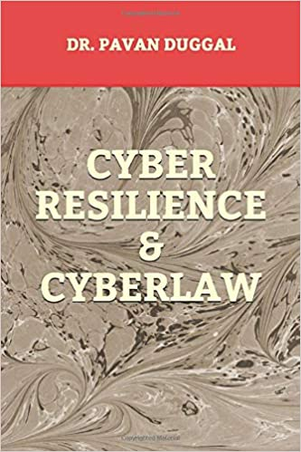
AI & CYBER SECURITY (CONTD…)
AI can open vulnerabilities as well, particularly when it depends on interfaces within and across organizations that inadvertently create opportunities for access by "bad actors" or disreputable agents.

Slide 18
Artificial Intelligence and ethical requirements
Unemployment versus Creation of Jobs
Inequality. How do we distribute the wealth created by machines?
Human Behaviour
Artificial stupidity. How can we guard against mistakes?

Slide 19
Artificial Intelligence and ethical requirements
Racist activities robots
Protection against Unintended Consequences
Singularity. How do we stay in control of a complex intelligent system?
Robot rights and humane treatment of AI

Slide 20
Artificial Intelligence and NORMATIVE requirements
Human rights first
Multi‑stakeholder smart regulation
Privacy and protection of personal data
A holistic approach to data
Safety is key and the most important point around AI. We need to ensure that AI systems are deployed safely.
Global collaboration – Need of the hour

Slide 21
ARTIFICIAL INTELLIGENCE AS A DOUBLE EDGED SWORD

Slide 22
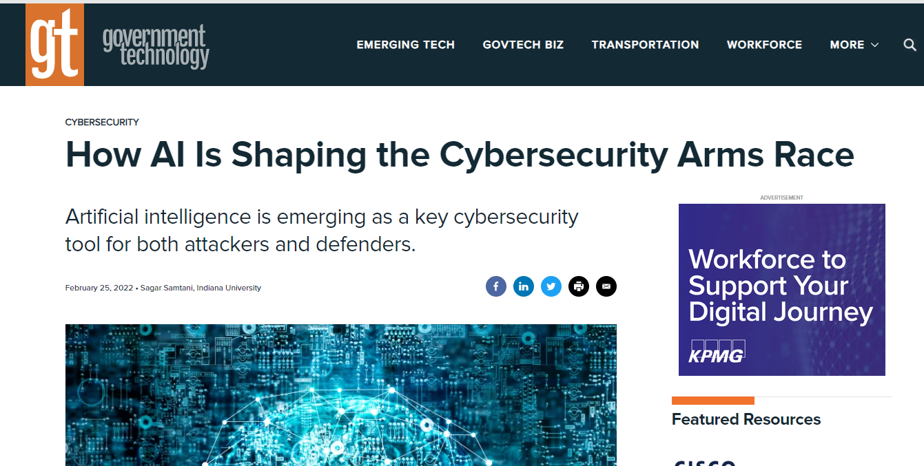
INCREASING CYBERSECURITY BREACHES IN THE CONTEXT OF AI

Slide 23
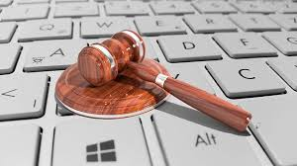
JURISDICTION AND ATTRIBUTION

Slide 24
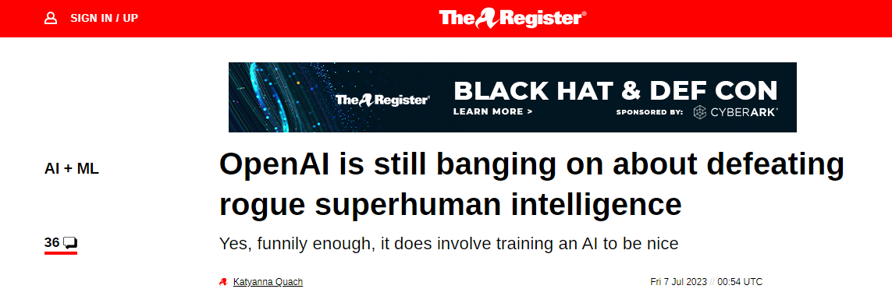
ROGUE AI , BIAS AND ETHICAL CONSIDERATIONS
AI is likely to go rogue and supersede human intelligence and therefore need for common code of conduct and normative legal rules.

Slide 25
LEGAL RIGHTS, DUTIES AND LIABILITIES OF AI

Slide 26
INCREASING CYBERSECURITY BREACHES IN THE CONTEXT OF AI

Slide 27
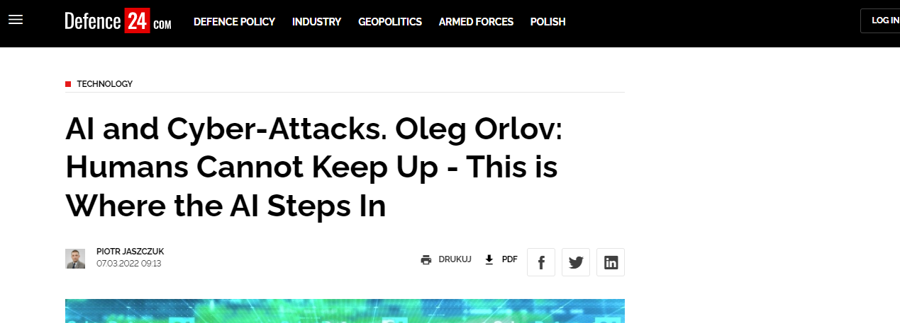
DUTY OF CARE AND DUE DILIGENCE FOR AI DEVELOPERS

Slide 28
AI CRIMES

Slide 29
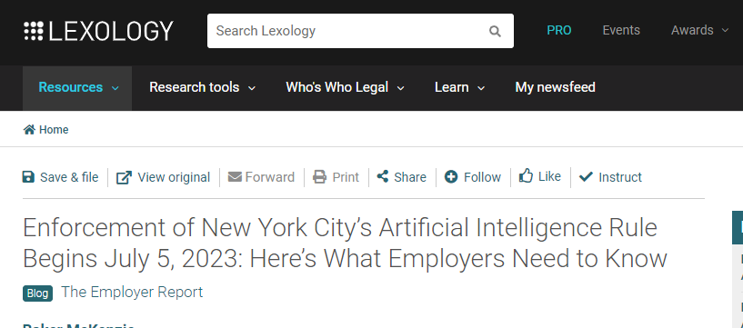
NEW YORK and illinois RULES ON Artificial Intelligence

Slide 30
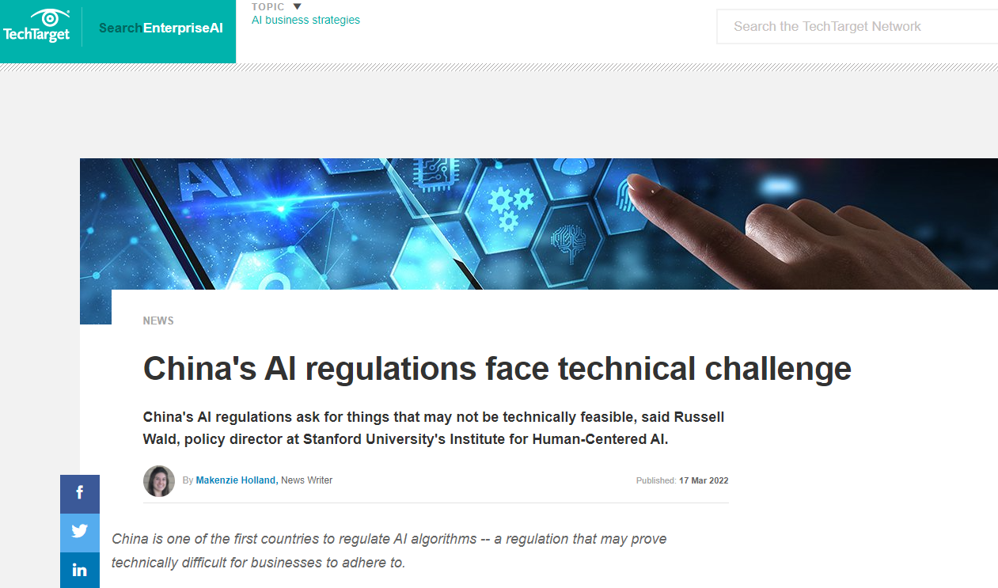
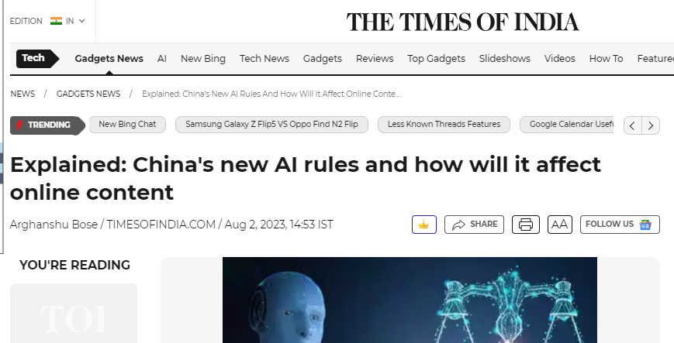
Chinese move on regulating artificial intelligence

Slide 31
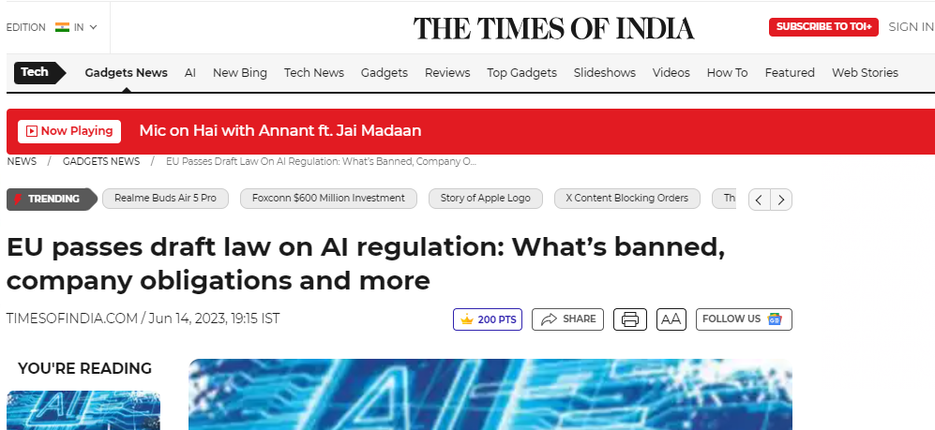
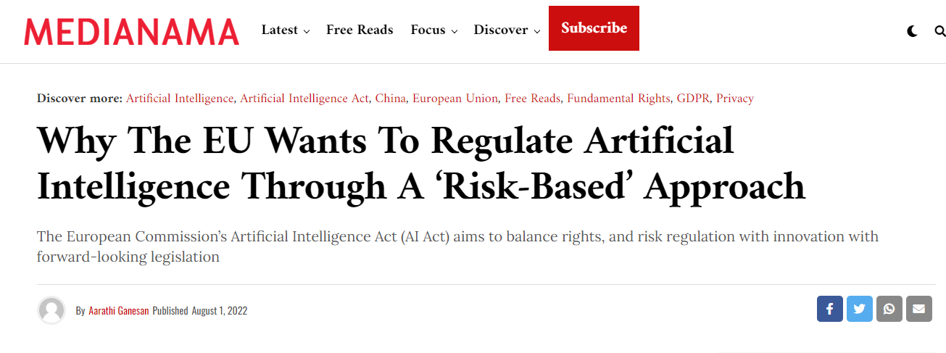
EU NORMS CONCERNING CYBERSECURITY IN THE CONTEXT OF AI

Slide 32
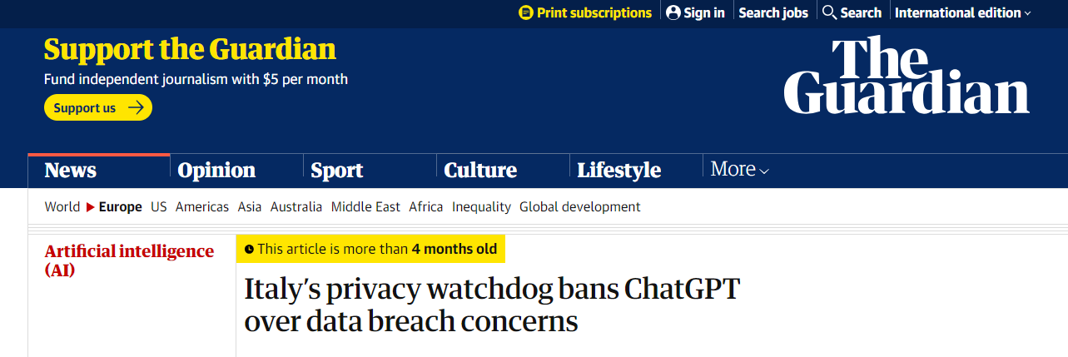
INCREASING CYBER SECURITY BREACHES

Slide 33
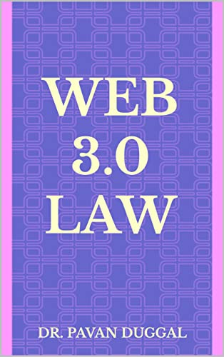
DEVELOPMENTS AT INTERNATIONAL LEVEL (CONTD...)
Different initiatives have begun in the direction of regulating Artificial Intelligence at global level.

Slide 34
NATIONAL POLICIES ON AI
Australia
Austria
Canada
China
Denmark
Estonia
Finland
France
Germany
India
Ireland
Italy
Japan
Kenya
Malaysia
Mexico
Russia
Singapore
Saudi Arabia
South Korea
Sweden
United Arab Emirates
USA
United Kingdom

Slide 35
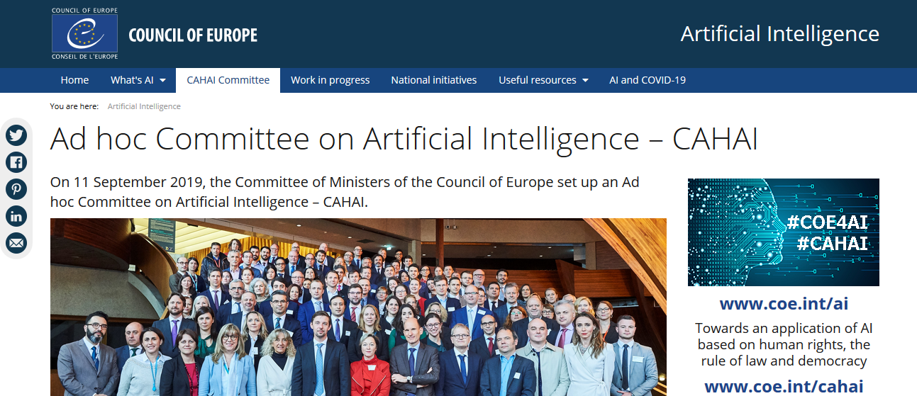
REGULATION OF ARTIFICIAL INTELLIGENCE – CAHAI OF COUNCIL OF EUROPE

Slide 36
GENERATIVE AI & LEGAL ISSUES
A majority of copyright laws throughout the world do not explicitly address Al-generated content.
With generative AI, it is not always clear who the creator is or how much involvement a human has in the creation of the work.

Slide 37
CHALLENGE OF REGULATING AI
There are, broadly speaking, two schools of thought on the issue of the regulation of AI.
The first is based on the premise that regulation is bad for innovation.
The other school of thought seeks to protect against potentially harmful creations that “poison the well” for other AI entrepreneurs and also believeed that national governments should act expeditiously to promote existing standards and guidelines or, where necessary, create new guidelines, to ensure a basic respect for the principle of “first, do no harm”.

Slide 38
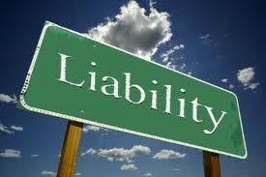
INTERMEDIARY LIABILITY IN THE CONTEXT OF AI

Slide 39
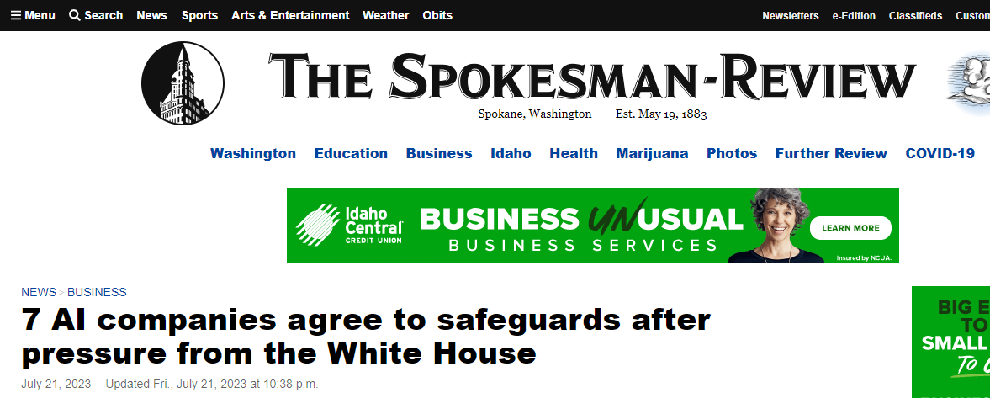
Initiative by 7 ai companies

Slide 40
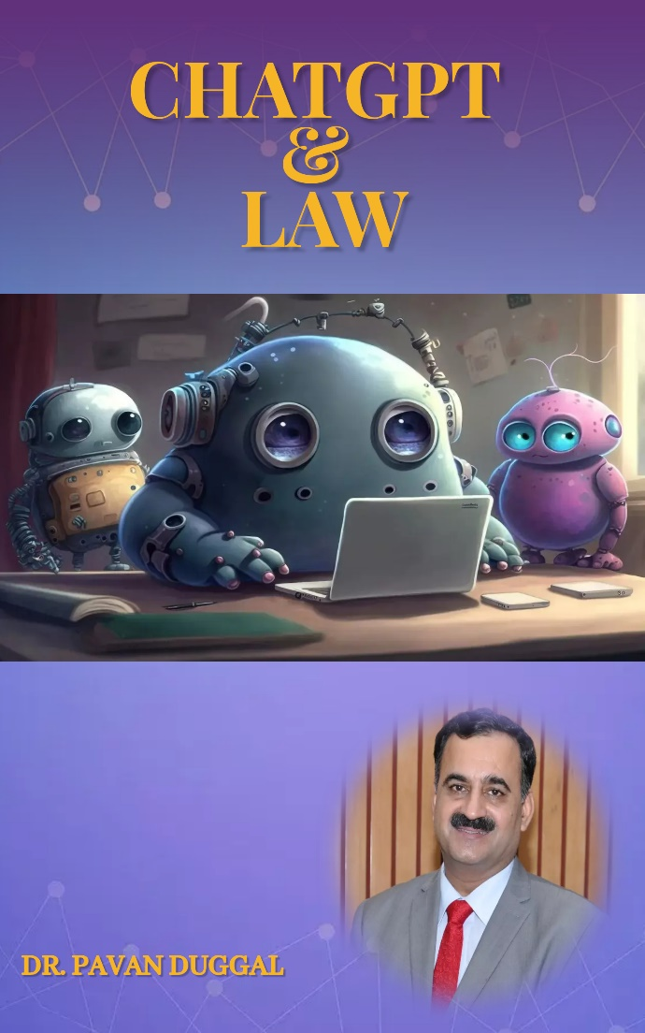
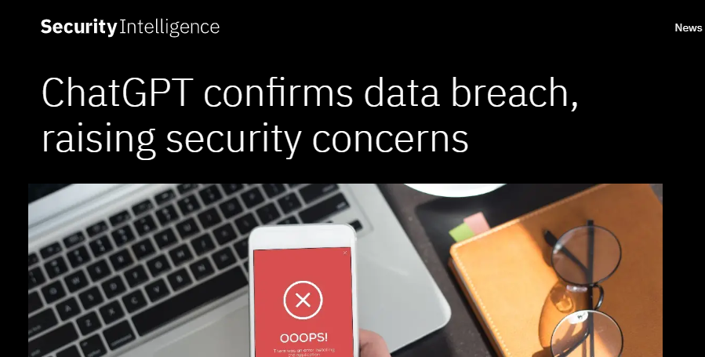
NEW EMERGING TECH - CHATGPT
© of images belongs to the respective copyright holders

Slide 41
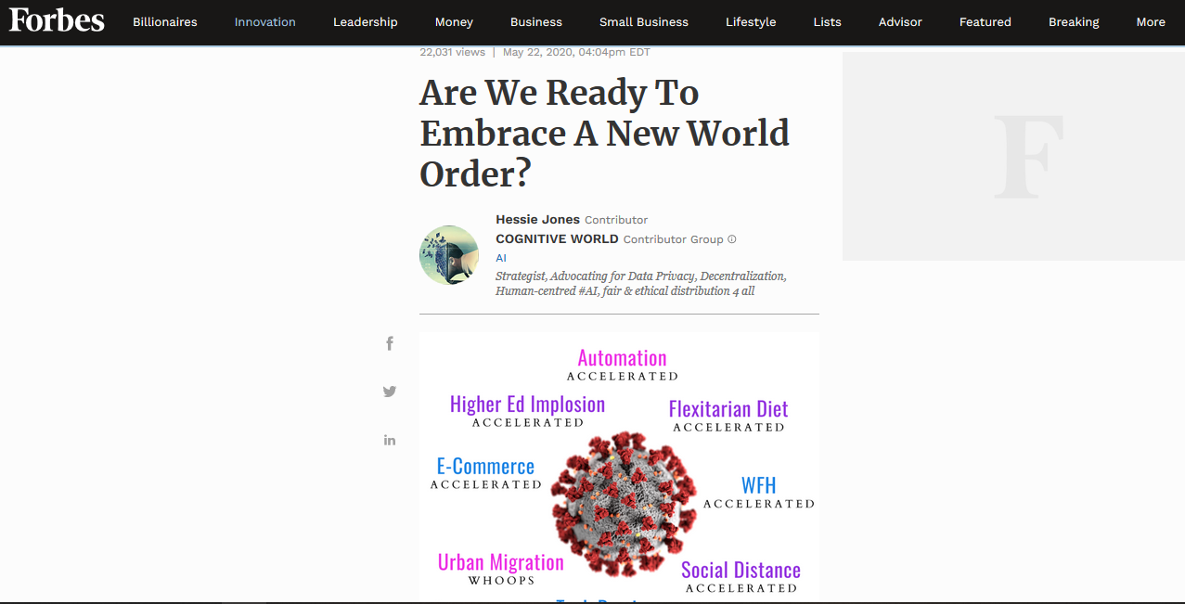
NEW CYBER WORLD ORDER

Slide 42
INCREASING CYBER SECURITY BREACHES

Slide 43
CYBER SECURITY – NEED FOR ADOPTION AS A CULTURE

Slide 44
NO INTERNATIONAL CYBER SECURITY LAW
NO INTERNATIONAL CYBER SECURITY LAW IN PLACE.
DIFFERENT COUNTRIES HAVE IN PLACE THEIR OWN DISTINCTIVE NATIONAL LAWS ON REGULATING CYBER SECURITY.

Slide 45
APPLICABILITY OF EXISTING CYBER SECURITY LAWS AND OTHER BILLS TO ARTIFICIAL INTELLIGENCE
China
Russia
Vietnam
Thailand
Australia (Anti-Encryption law)
Singapore
Egypt
New York
Germany
Zimbabwe
California
Macau / Taiwan

Slide 46
CHALLENGE OF REGULATING AI (CONTD..)
Countries should develop a data strategy that promotes innovation and consumer protection.
Currently, there are no uniform standards in terms of data access, data sharing or data protection.

Slide 47
CHALLENGE OF REGULATING AI
Almost all the data is proprietary in nature and not shared very broadly with the research community, and this limits innovation and system design.
AI regulation will be a necessity, particularly in the areas of safety and errors, liability laws and social impact.

Slide 48
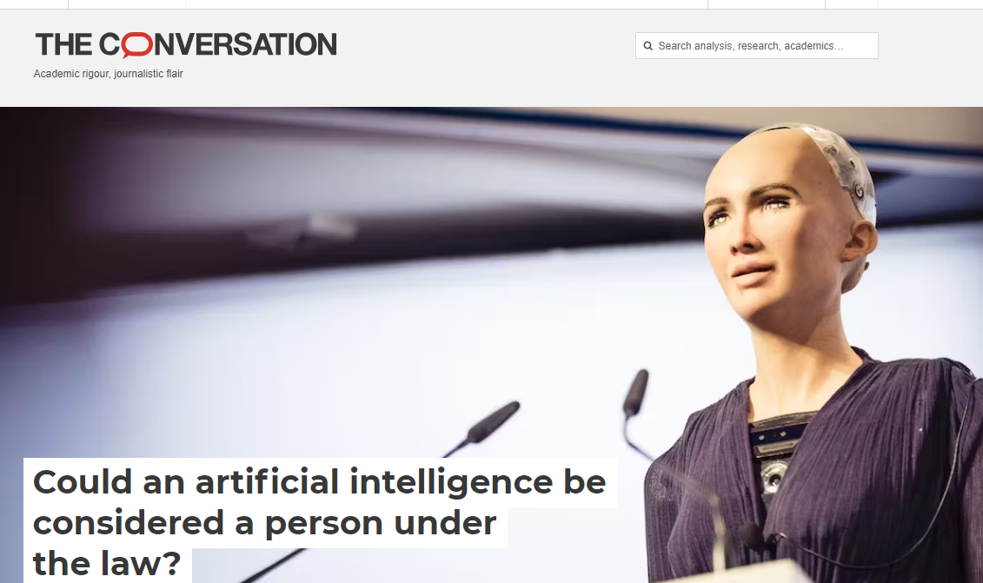
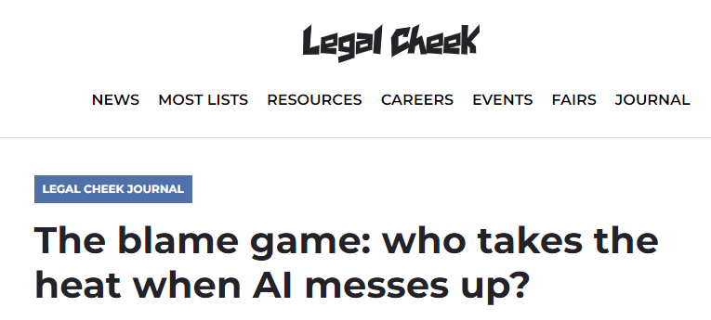
International developments on ai
There is an arms race for regulating AI in different countries who are coming up with new precedents.

Slide 49
International developments on ai
United States: Multiple class actions filed against providers of foundational generative AI large language models (LLMs) and technologies:-
P.M. et al v. OpenAI LP et al, No. 3:23 Civ. 3199 (N.D. Cal. Jun. 28, 2023)
Tremblay et al v. OpenAI, Inc. et al, No. 4:23 Civ. 3223 (N.D. Cal Jun. 28, 2023)
Silverman et al v. OpenAI, Inc. et al, No. 3:23 Civ. 3416 (N.D. Cal Jul. 7, 2023)
Kadrey et al v. Meta Platforms, Inc., No. 3:23 Civ. 3417 (N.D. Cal Jul. 7, 2023)
J.L. et al v. Alphabet Inc. et al, No. 3:23 Civ. 3440 (N.D. Cal Jul. 11, 2023)

Slide 50
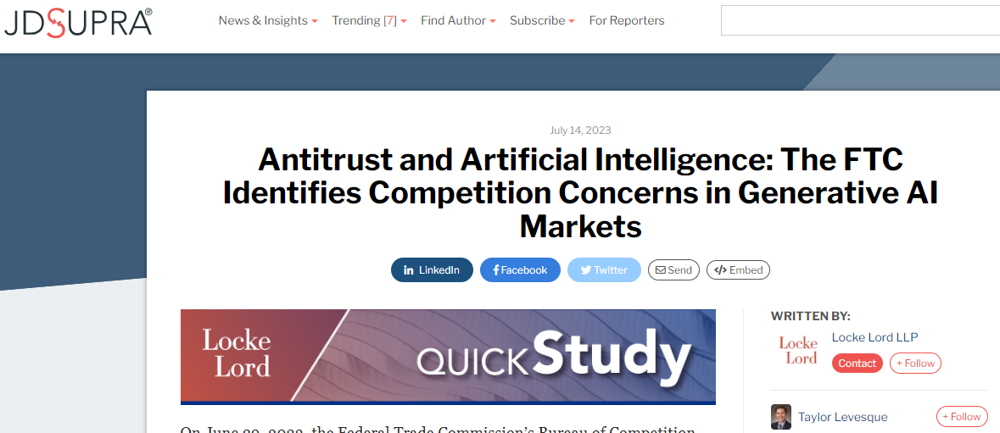
International developments on ai

Slide 51
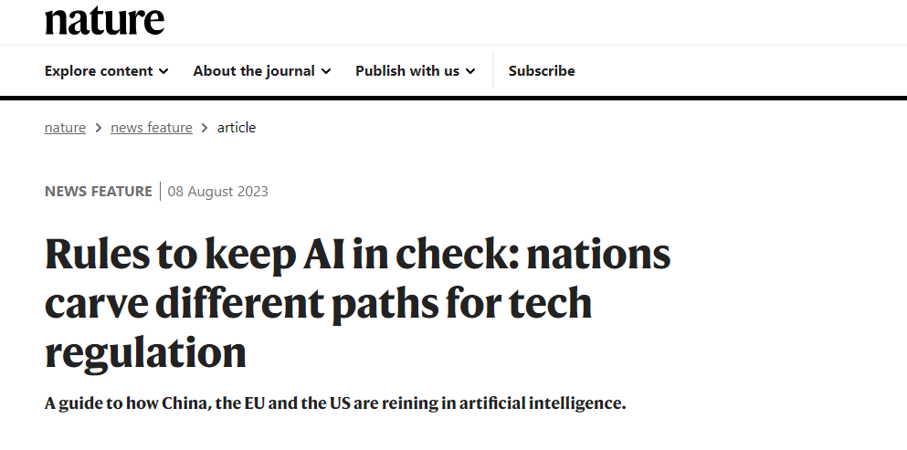
DEVELOPMENTS AT INTERNATIONAL LEVEL (CONTD...)
Different initiatives have begun in the direction of regulating Artificial Intelligence at global level.
Need for common international principles on legal recognition of Artificial Intelligence.

Slide 52
Un adhoc committee on cybercrime

Slide 53
BLOCKCHAINS & cyberlaw

Slide 54
INTERNET OF THINGS

Slide 55
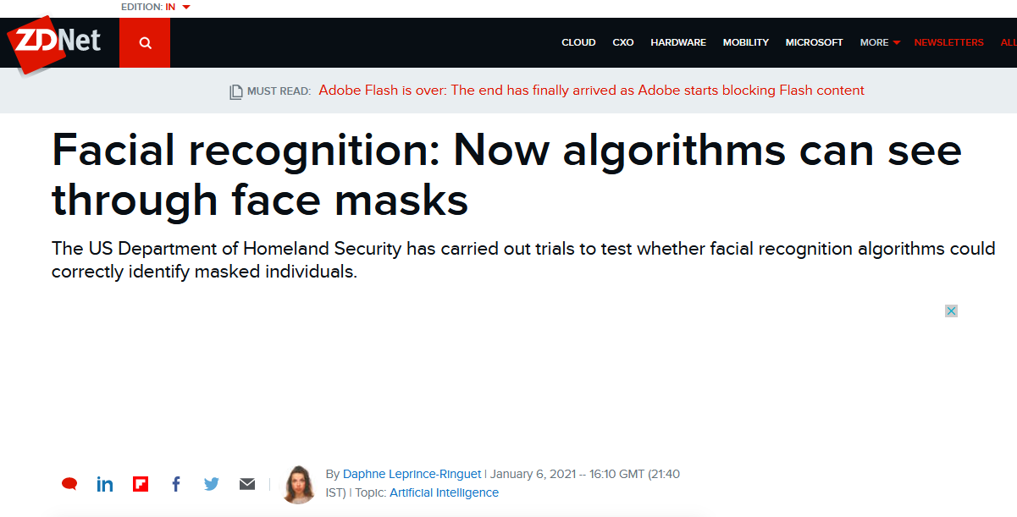
FACIAL RECOGNITION & PRIVACY

Slide 56
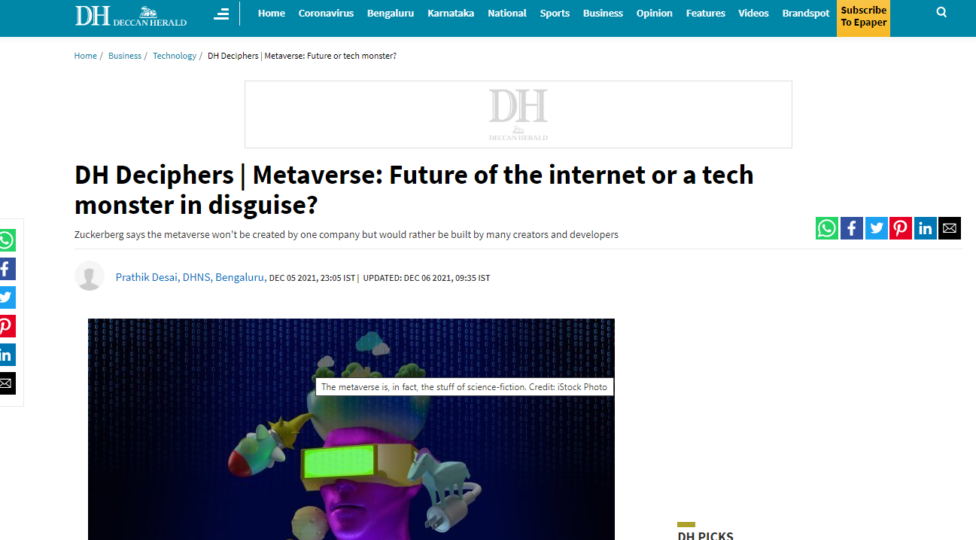
METAVERSE – ITS ADOPTION & CONNECTED LEGAL CHALLENGES

Slide 57
Security becomes paramount in the context of Edge Computing

Slide 58
WEB 3.0

Slide 59
DIGITAL HUMANS POWERED BY AI

Slide 60
DARKNET AND CYBERCRIMES

Slide 61
Way forward
Need for holistic approaches on coming up with common conduct and normative and legal rules
PMP on Information Security is aiming to get more visibility at global level for making presence felt on international initiatives of common conduct on normative and legal rules.
Legal developments are constantly evolving.
Common conduct will have to keep in mind constantly evolving legal developments.

Slide 62
Legal principles are evolving to regulate Artificial Intelligence.
Projects of Artificial Intelligence Law Hub:
Legal principles to enable AI for public good;
Legally enforceable ethical standards and behaviour for AI;
AI and cyber security – the uneasy legal marriage;
Various other projects are in the pipeline.

Slide 64
INTERNATIONAL CERTIFICATION COURSES @ CYBERLAW UNIVERSITY (CYBERLAWUNIVERSITY.COM)

Slide 65
AI COURSES @ CYBERLAW UNIVERSITY (CYBERLAWUNIVERSITY.COM)

Slide 66
FIGURES SPEAK
Courses offered by Cyberlaw University, as of now, have been done by more than 28,500 students from 174 countries speaking 53 national languages.
Course entitled “Cyber Security Law” has been adjudged as best course out of 10 best courses by Douglas Hollis, one of the renowned US organization.
Tech Republic of USA for adjudged the Course entitled “Cyberlaw, Cybercrime & Cybersecurity in the Coronavirus Age” as one of the 16 best online courses.

Slide 67
International Conference on Cyberlaw, Cybercrime & Cybersecurity 2023 (29th, 30th November & 1st december, 2023)
www.cyberlawcybercrime.com

Slide 68
PROMINENT SUPPORTERS ICCC 2023

Slide 69
THEME @ ICCC 2023
“RISE OF EMERGING TECHNOLOGIES AND THEIR IMPACT”
© of images belongs to the respective copyright holders

Slide 70
SNAPSHOTS OF ICCC SINCE ITS INCEPTION IN 2014

Slide 71
SNAPSHOTS OF ICCC SINCE ITS INCEPTION IN 2014

Slide 72
CONCLUSION
For humanity, it matters as to how policy issues are addressed, ethical conflicts reconciled, legal realities resolved, and how much transparency is required in AI and data analytic solutions, as the Artificial Intelligence law jurisprudence evolves in the coming times.

Slide 73
A PRESENTATION BY DR. PAVAN DUGGAL ADVOCATE, SUPREME COURT OF INDIA CHAIRMAN, INTERNATIONAL COMMISSION ON CYBER SECURITY LAW PRESIDENT, CYBERLAWS.NET CHIEF EXECUTIVE, ARTIFICIAL INTELLIGENCE LAW HUB FOUNDER-CUM-CHANCELLOR, CYBERLAW UNIVERSITY
CHIEF EVANGELIST, METAVERSE LAW NUCLEUS
HEAD, PAVAN DUGGAL ASSOCIATES pavan@pavanduggal.com
pavanduggal@yahoo.com

